Slide 1

AI Governance & More
EWF Senior Leaders Forum + Emerging Leaders Forum
Diana Kelley

Slide 2
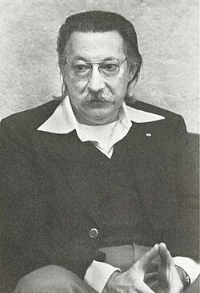
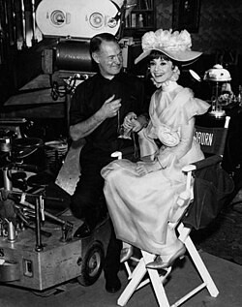
My AI Journey
The Research Conference
Where AI Began
1956
A proposal for the
Dartmouth Summer Research Project on Artificial Intelligence
©2025 Noma Security

Slide 3
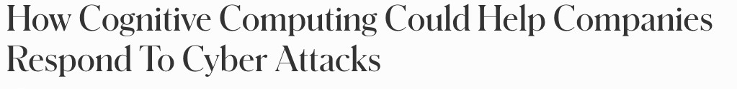





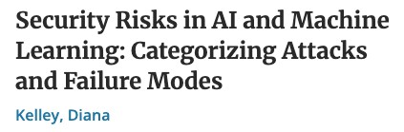
©2025 Noma Security
©2025 Noma Security

Slide 4




AI Adoption is Moving Faster than
Governance
Employees
Vendors
Attackers
Writing · Coding Summarizing · Research
SaaS platforms embedding AI into every product
Phishing · Recon Social engineering at scale
©2025 Noma Security

Slide 5


Start with Inventory:
You Can't Govern What You Can’t See
Q1 Who is requesting it & what problem does it solve?
Q2 What data will be used — and can it be retained?
Q3 Is a third-party model or vendor involved?
Q4 Will it affect customers, employees, or decisions?
AI Request Intake
Q5 Who reviews outputs? Who owns accountability?
©2025 Noma Security

Slide 6
Risk-Tier the Request Before You
Over-Engineer the Review
LOW RISK
Personal
productivity
Public
data
MODERATE
Internal workflows
Non-public data
HIGH RISK
Sensitive
data
Regulated workflows
CRITICAL
Autonomous action
Safety implications
← Lower scrutiny
Higher scrutiny →
©2025 Noma Security

Slide 7


AI-Assisted Development
Changes the SDLC
Requirements
Design
Code Gen
Code Review
Testing
Docs
Threat Model
Remediation
AI APPEARS HERE ↑
!
!
!
!
Insecure code suggestions
Vulnerable
dependencies
Spaghetti
code
Misunderstood
output
AI-generated code = untrusted until reviewed, tested, and scanned
©2025 Noma Security

Slide 8


Make AI Coding Safer Without Slowing Developers Down
Approved tools only
SAST · SCA · Secrets scanning
No secrets or sensitive data in prompts
Threat modeling for AI-generated features
Mandatory human code review
License & dependency review
Security shows up as enabler — not gatekeeper

Slide 9

How AI is Enhancing Security Programs
Alert triage & summarization
Threat intel
enrichment
Phishing
analysis
Detection
engineering
Security
questionnaires
Policy & control mapping
Incident timeline generation
Vuln
prioritization
Tabletop exercise
design
User education
content
AI assists security judgment — it does not replace it in high-impact decisions
©2025 Noma Security

Slide 10
From Ad Hoc to Managed AI
5
4
Optimized
3
Managed
Continuous AI monitoring and governance integrated across enterprise.
Full automation for governance and testing.
2
Defined
All AI Inventoried &
risk-rated.
Some continuous policy, access control, and runtime.
Point in time testing.
1
Reactive
Policies & intake exist but are not always used.
Some guardrails and testing.
Unaware
Reviews after the fact.
Partial inventory.
AI use invisible.
Shadow AI
©2025 Noma Security

Slide 11
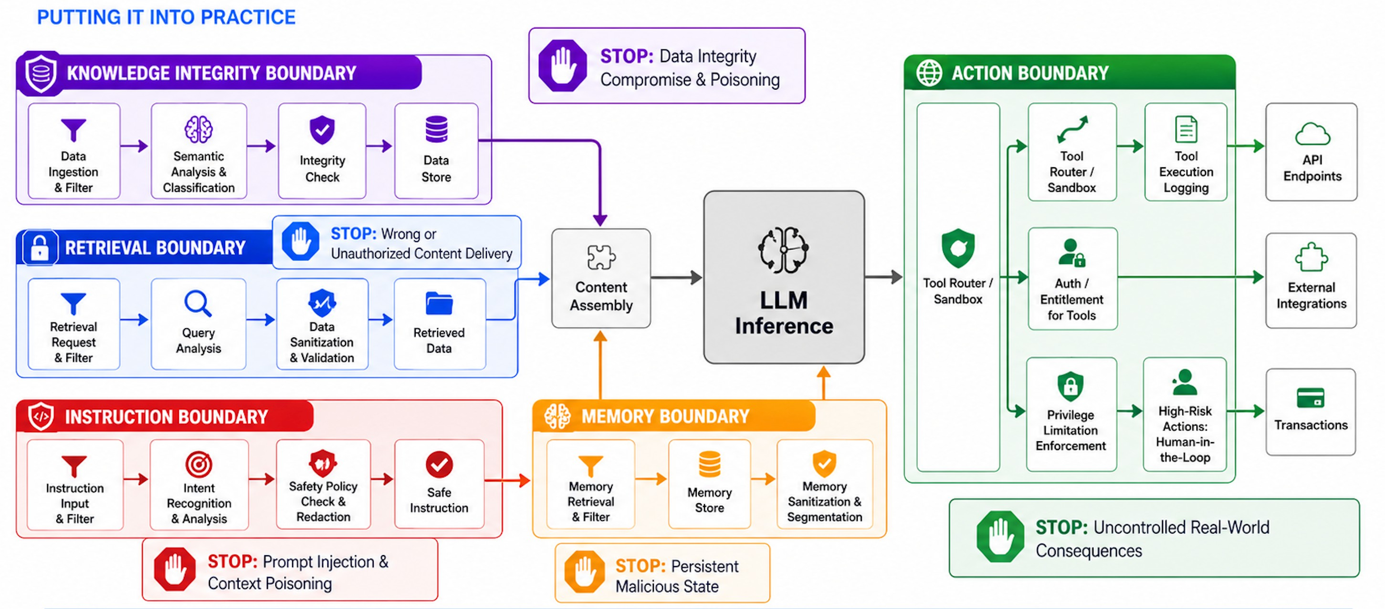
Layered Controls Across Trust Boundaries
Putting it Into Practice
Context Window
©2025 Noma Security
©2025 Noma Security
©2025 Noma Security

Slide 12






Layered Controls Across Trust Boundaries
To Protect Organizations
Two ActionsToday
SEE IT
Inventory & monitoring
SORT IT
Risk-tier & review
1
Start or refresh your AI inventory
SECURE IT
Controls & guardrails
USE IT
Business & security value
2
Create a risk-based intake & review path
IMPROVE IT
Continuous optimization
©2025 Noma Security

Slide 13
Resources: Keeping up with AI Trends
Daily Security Brief Agents
  My own Claude Co-work and ChatGPT Agents
Noma Slack Channel
  If you’re company doesn’t have one, create your own!
MIT Sloan Mgmt AI - https://sloanreview.mit.edu/tag/artificial-intelligence/
HBR ML and AI - https://hbr.org/topic/subject/ai-and-machine-learning
TechCrunch AI — https://techcrunch.com/category/artificial-intelligence/
VentureBeat AI — https://venturebeat.com/category/ai/
Hugging Face Daily Papers — https://huggingface.co/papers
©2025 Noma Security
©2025 Noma Security

Slide 14






Using AI Everyday, My List. What’s Yours?
Drafting & Editing
Research
Meeting Support
Outlines · First drafts · Tone
Comparing sources · Key points
Agendas · Notes · Summaries
Security Work
Learning
Productivity
Threat models · Tabletops
Explain topics · Study plans
Planning · Brainstorming
⚠ I do not use AI as the final authority for facts, sensitive decisions, confidential data, or ethical judgment
©2025 Noma Security

Slide 15
Thank You!

